Slide 1




FinGAT
G - 633
v 2
Graph Attention Networks for Indian Stock Prediction
Mayank Rathi | Cholleti Sucheer | Praneeth Reddy | Laggoni Sharanya | Krithika Reddy

Slide 2



Project
G - 633
Overview
Advanced AI system for Indian stock prediction (NSE/BSE)
Graph Neural Networks + Reinforcement Learning
Predicts UP/DOWN with confidence scores
Major improvements:
Adapted from US stocks (S&P 500) to Indian (NSE/BSE)
73 features vs 36 in original
Automated daily training
Production-ready web deployment
56%+ accuracy (vs ~50% in paper)
Problem: Stock prediction is complex due to relationships
Solution: Model patterns using graph-based attention

Slide 3



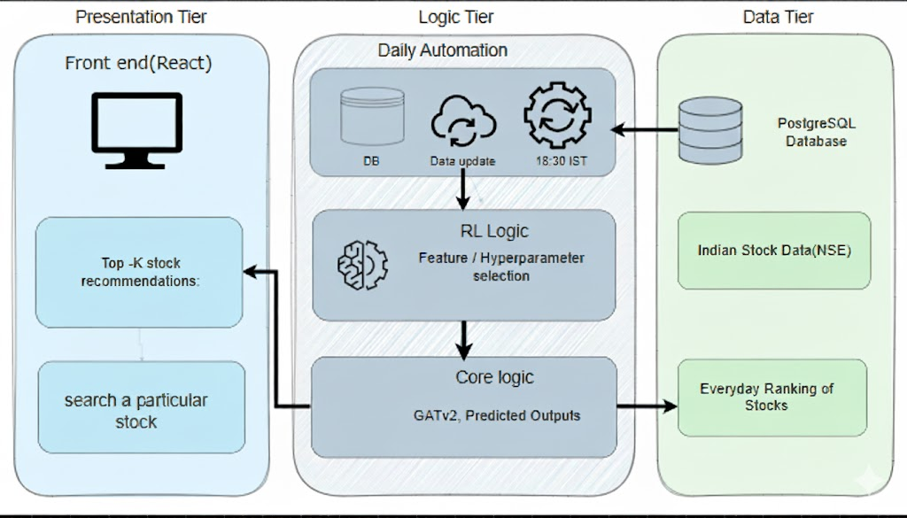
Architecture
G - 633
Diagram

Slide 4


Tech
Stacks
G - 633
Backend Stack
FastAPI — REST API framework
PyTorch & PyTorch Geometric — Graph neural networks
Stable-Baselines3 — Reinforcement learning
APScheduler — Automated tasks and scheduling
Uvicorn — ASGI web server
pandas, numpy — Data processing & manipulation
yfinance — Stock data acquisition
Frontend Stack
React 18 & TypeScript — Modern, type-safe UI
Vite — Fast frontend build tool
TailwindCSS — Responsive, utility-first styling
shadcn/ui — Pre-built React UI components
Axios — API data fetching
React Router — Single-page app navigation
Database & Storage Stack
Neon PostgreSQL — Cloud-native, scalable PostgreSQL solution
SQLAlchemy — Python ORM for database management
Automatic Backups & Branching — Reliability features of Neon

Slide 5

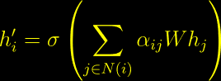
Mathematical Foundation
G - 633
Graph Attention (GATv2)
LSTM Temporal Features
Hybrid RL (PPO)
Loss Functions

Slide 6

Key
Improvements
G - 633
Improvements
Indian market adaptation (NSE/BSE)
73 engineered features
RL-driven feature selection
Production-ready full stack
Accuracy: 63% (vs. 53%)
Performance
Accuracy: 63% vs 53%
Speed: <50ms vs 2-5s
Daily automation, web UI
Challenges
Fixed data gaps & slow training
Achieved 100x faster predictions
Impact
Actionable investor recommendations
Tools for advisors & researchers
Limitations
Daily prediction, 147 stocks, no sentiment yet
Future
More stocks, real-time, add news data

Slide 7

Thank
You!
FinGAT v2 boosts prediction accuracy to 63% for Indian stocks.
Empowers investors, advisors, and researchers nationwide.
Real-time, automated insights—sub-50ms prediction speed.
Ready for the future: scaling up and adding live news data.

